Slide 1

Both Sides of the Legacy Gift
Benefits for Organizations & Donors

Slide 2
Getting to Know Each Other
Why do you do what you do?
How does your organization serve your clients/mission?
What is your role?

Slide 3
Getting to Know Each Other
Who has a legacy giving program?
Does your organization have an endowment?
Do you have policies for legacy giving?
Have your board members made a legacy gift?

Slide 4
Get Some Attitude!
Be clear about why
Why do you have or aspire to have a Legacy Giving program?
Empower donors in their passion to help your clients
Develop long term financial resources to serve future client needs
Your personal mission

Slide 5
A Plan
Make the Case for Legacy Giving
Integrate Legacy Giving into core of your organization’s activity
  Gain Board and organizational commitment
    Find your Board Champion - Get board members to commit to a legacy gift as example to other donors
    Presentations/reports to board
    Presentations/reports to staff
Know we can do it
Add Value in Donors’ Philanthropy
Ask for Legacy Gifts
Recognize Legacy donors
Loyal Contributor program
Engage professionals in the field and add to Legacy Giving Advisory Council as appropriate
Establish measures for evaluating efforts
Steward your donors

Slide 6
Make the Case for Legacy Giving
For the inside sell -
        Board Buy-In
For Donors

Slide 7
Plan
Start with the Board
What would you say to individual board members?

Slide 8
Barriers to Success
What keeps it from happening?
  Personal
  Organizational

Slide 9
Personal Barriers
Barriers
  What barriers have you encountered?
  What barriers do you think you might encounter?

Slide 10
Personal Barriers
Fear
  What are your fears?

Slide 11
Personal Barriers
Fear
  Saying something wrong
  Messing up a relationship with a good donor
  Not fully understanding
  Asking for more may result in getting less

Slide 12
Your Knowledge about Legacy Giving
Legacy Gifts vs. Annual Giving
Annual Giving:
        Sharing your Income
Legacy Giving:
        Sharing your Assets

Slide 13
What are donors thinking when you ask for some of their assets
Typical goals for our assets:
Maintain our lifestyle
Establish goals for our children and fund them as needed
Leave a Philanthropic Legacy
        Communicate our values
        Give back…or similar goals relative to our community…our passions
“What if things don’t turn out as well as we had hoped?”
“What if our needs or those of our children are more costly than we foresee today?”

Slide 14
Legacy Giving Primer
Legacy Gifts may:
Be revocable
Be irrevocable
Benefit your organization:
  Now
  After donor’s life
  Forever
Be tools in donor’s financial planning:
  Increase cash flow from their assets
  Maximize after tax benefits to heirs
  Diversify donor’s assets

Slide 15
Legacy Giving Techniques
Revocable Gifts
  Bequests
  IRA beneficiary designations
  Life insurance beneficiary designations
Irrevocable Gifts
  Gifts of life insurance policies
  Gifts of the remainder interest in your home
  Charitable gift annuities
Endowment Gifts that continue annual giving Forever. Partnering with UWCNM and the Albuquerque Community Foundation.

Slide 16
Revocable Gifts
Bequests
  IRA beneficiary designations
  Life insurance beneficiary designations
Gifts ANYONE Can Make

Slide 17
Did You Know?
Percentage of Americans without a will
Greatest Barrier to Asset Giving
Percentage of American with Qualified Retirement Plans
65%
Irrevocability
71%

Slide 18
Irrevocable Gifts
Gifts of life insurance policies
  Gift of the remainder interest in your home
  Charitable gift annuities

Slide 19
Endowment Gifts
Continue annual giving forever
Partner with United Way of Central New Mexico and the Albuquerque Community Foundation

Slide 20
Asking for Legacy Gifts
It’s about the donor
Legacy Giving is
Dreaming:
        About what the donor would like to help happen in the community
Living the dream:
        For the rest of one’s life without writing a check

Slide 21
Getting the Meeting
Consider why prospects may be saying no
  Don’t want to deal with mortality
  Don’t want to deal with their families
  Don’t want to feel restricted

Slide 22
Toughest Hurdle –
Getting the Meeting
“Our Children
My spouse
My parents
I
don’t want to deal with
My
Our
Their
  Mortality
  Intentions
  Laziness
  Greed
  Fighting
  Tell me how to live
  Emotions
  Reactions
… and therefore we haven’t talked about the assets and what the plan is for them.”

Slide 23
Getting the Meeting
Ask for the Meeting
We’re setting out to offer ways for donors like you who are already giving so much to give without writing another check
Your annual gifts allow us to serve xx families every year. I want to visit about finding a way to continue your annual gifts after your lives / after retirement
I need your help. You are a key volunteer / valued donor and we need your input on what we’re doing
I promise not to ask you for another check

Slide 24
The Legacy Giving Conversation
Have materials ready to send or leave
The case for legacy gifts and for your clients
Donor stories / testimonials
Letter or brochure dealing with revocable gifts and how to include your organization
A list of your Professional Advisory Committee Members

Slide 25
The Legacy Giving Conversation
“Someone you don’t know will miss you after your lives… the life that your annual gift could have improved.”
Ask donors why they resonate with your organization’s mission
  Encourage them to share their values and their history with their families
Ask donors about their priorities for their lives and about how they would like to be remembered

Slide 26
Talk about Values
Assist donors with creating a legacy for their families
Empower donors to give beyond their perceptions of their ability to give

Slide 27
Recognition of Legacy Donors
Legacy societies
Newsletters and websites
Pins
Handouts

Slide 28
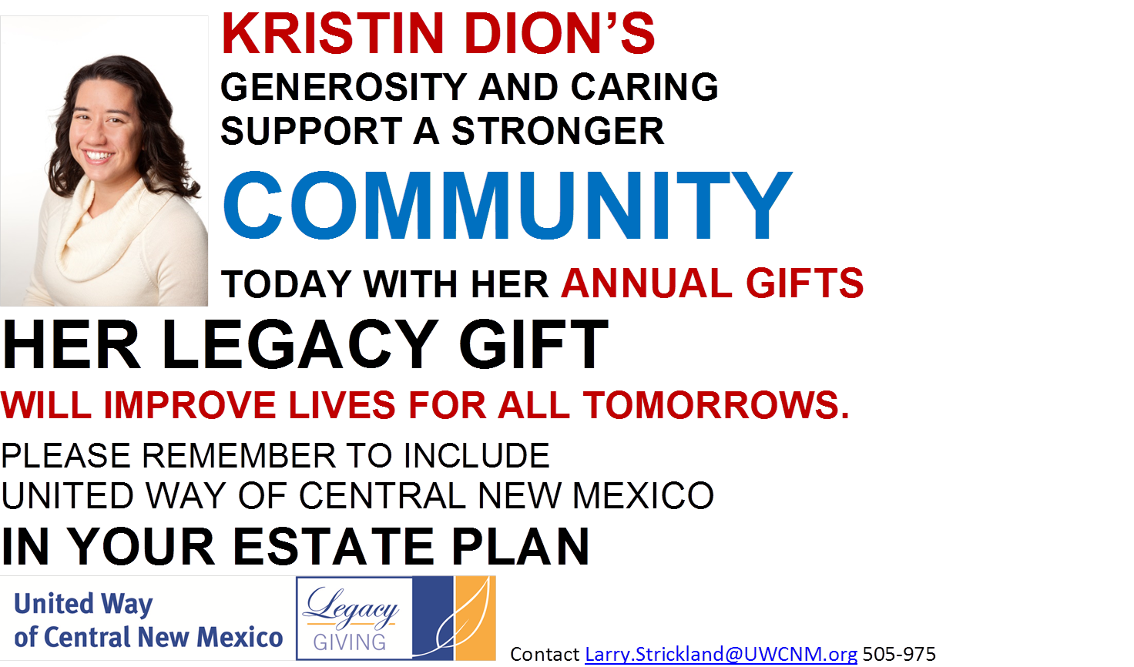

Slide 29
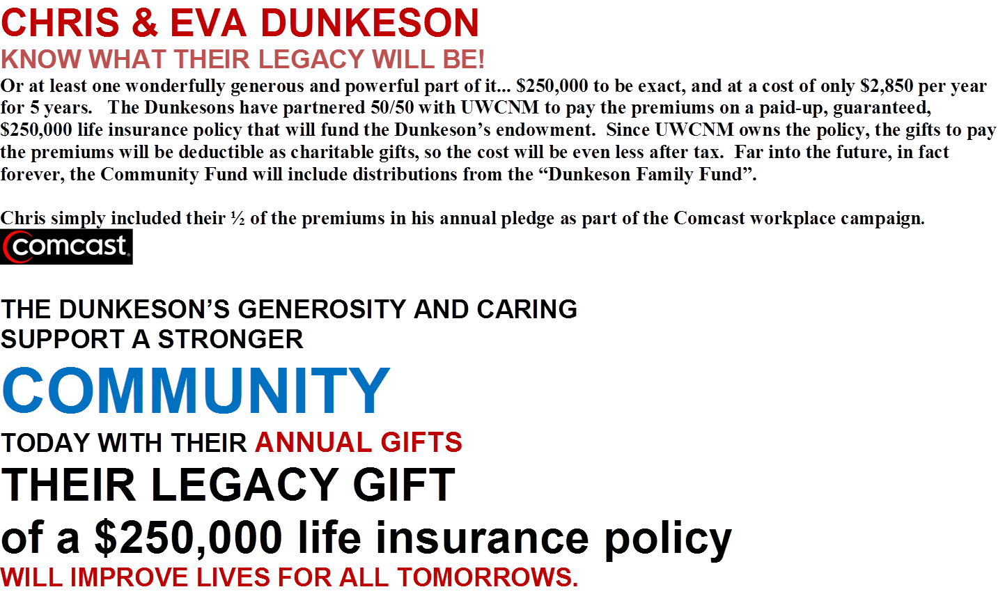

Slide 30
Promoting Legacy Gifts
Stories, stories, stories
Checkboxes on your response cards, pledge forms, etc.
Newsletters
Websites
Seminars
Surveys

Slide 31
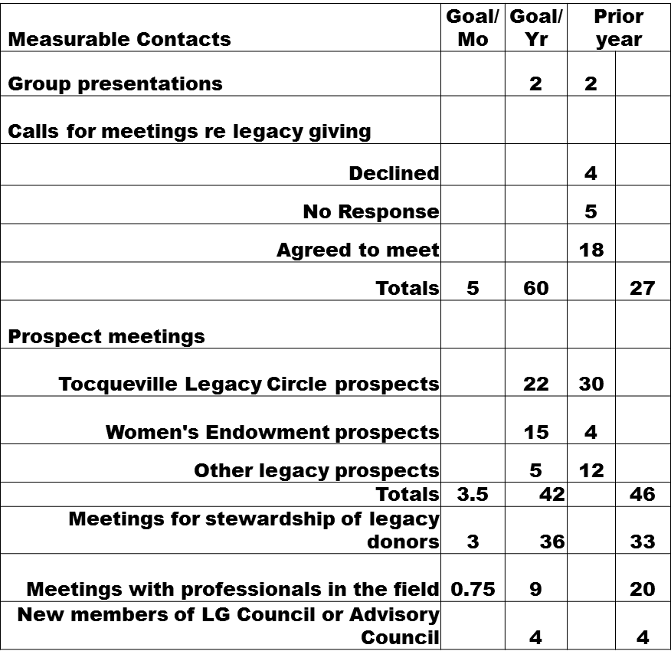
Evaluating Efforts

Slide 32
Resources
New Mexico Planning Giving Roundtable, contact larry.strickland@uwcnm.org
Partnership for Philanthropic Planning, www.pppnet.org
Inspired Philanthropy, Your Step-by-Step Guide to Creating a Giving Plan and Leaving a Legacy, Third Edition by Tracy Gary with Nancy Adess, foreword by Suze Orman, 2008
Legacy, Conversations about Wealth Transfer by Northern Trust Corporation, 2008
Professional Advisors’ Guide to Planned Giving, 2006 Edition by Kathryn W. Miree, 2006
Splitting Heirs, Giving Your Money and Things to Your Children Without Ruining Their Lives, by Ron Blue with Jeremy White, 2004

